Slide 1


The Baker Lab
Using Microbiology & Bioinformatics to discover how the oral microbiome impacts health & disease
Email: bakerjo@ohsu.edu
Twitter: @jonbakerlab
GitHub: @jonbakerlab
Instagram: @jonbakerlab
PI: Jonathon L. Baker, Ph.D.
Assistant Professor
Department of Oral Rehabilitation & Biosciences
Oregon Health & Science University

Slide 2
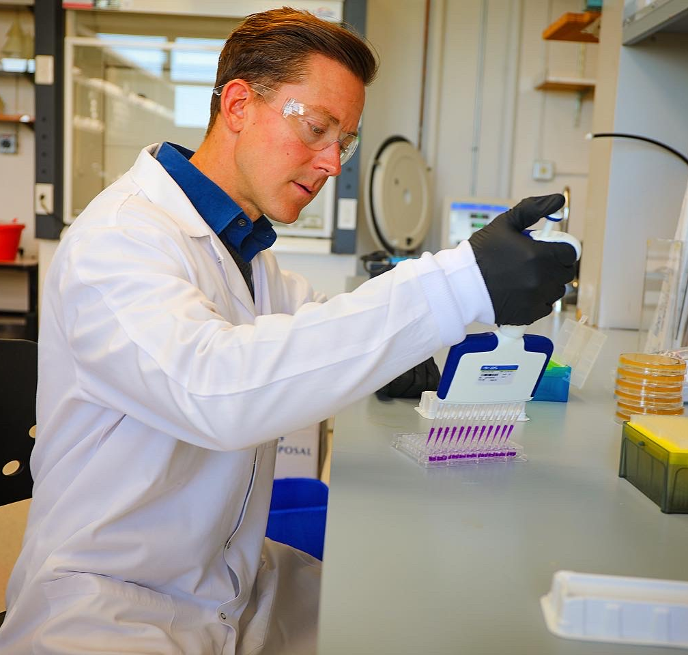
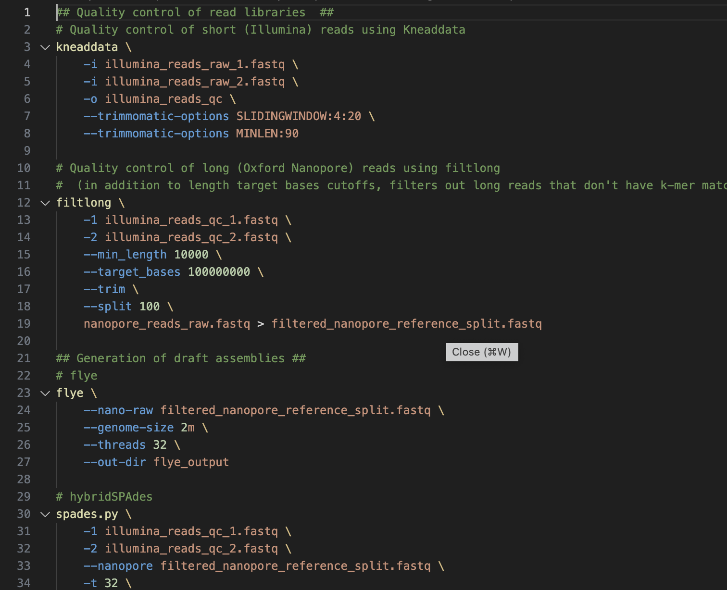
Microbiology and Bioinformatics
Microbiology
Molecular biology
Biochemistry
Bioinformatics
Computational biology

Slide 3


Why I love academic science
It’s a challenge!
Flexibility!
Variety!
You can make it your own!
You get to travel!

Slide 4
Scientific Writing & Planning a Project
(and Using git & mamba/conda for bioinformatics)
Jonathon L. Baker, Ph.D.
Assistant Professor
Department of Oral Rehabilitation & Biosciences
Oregon Health & Science University

Slide 5
Planning a Project
Address a knowledge gap
What is the impact & significance? Impact is important for getting funding, but…
Many important discoveries have occurred from “less impactful” lines of research
TAQ polymerase -> PCR
Luminous jellyfish -> green fluorescent protein (GFP)

Slide 6
Planning a Project
Try to think all the way through to a final report or paper
What will the figures look like?
How will the research tell a story? One experiment and results should lead into follow-up experiments
Several smaller manuscripts or one larger one?
Pros & cons?

Slide 7
Writing a scientific paper: authorship
What are the two most important positions?
First & last
What do they indicate?
What deserves authorship?
Discuss authorship and make things very clearly sorted out at the beginning of the project to head off any issues
Notes:
It comes with practice,

Slide 8
Writing a scientific paper: general tips
It comes with practice
It should feel like you’re repeating yourself
It’s your job to make things easy for the reader
It’s formulaic
Spend time on figures
should look professional
easy to read
large bold text
titles for each panel
Make color schemes consistent throughout
Notes:
It comes with practice,

Slide 9
Writing a scientific paper: sections
Abstract (usually 200-250 words)
Concise summary of the study
1-2 sentences introducing the topic and its importance
1-2 sentences introducing the problem or knowledge gap
“In this study…” 1 sentence for each of the major results or figure from the study (some omitted if many figures)
1-2 sentences about the conclusion, impact, and/or future directions

Slide 10
Writing a scientific paper: sections
Introduction
Gives some background, starts broad, introduces the main concepts.
Helpful to reader to cite good review articles
Introduce the problem and/or knowledge gap
“In this study…”
Don’t overcomplicate & ramble…common mistake

Slide 11
Writing a scientific paper: sections
Materials & Methods
FAIR = Findable, Accessible, Interoperable, Reproducible
As much detail as possible, another lab should be able to repeat & reproduce you experiments and (hopefully) your results using the Materials & Methods as a set of instructions
Cite where you obtained the protocols, but useful to still write out the protocol & instructions
List company where you purchased reagents
For any code, make the code publicly available (GitHub), at minimum provide version of all programs used, and parameters for all analysis tools
For sequencing, mass spectrometry, etc., make raw data files available in public repositories (GenBank for genomes, SRA for raw sequences, MASSive for mass spec, etc.)
List all strains, cell lines, plasmids, etc. used and their source

Slide 12
Writing a scientific paper: sections
Results
Should be written very ‘matter of fact’ly
”To discover if __________ , we did _________ . We saw _______ , meaning _______ .“
Personal preference: avoid the first person, you can always rephrase to remove pronouns
“To discover if _________ , _________ was done. __________ occurred, indicating _________ .”
Each paragraph or section goes with a particular experiment, usually along with a figure. Concludes with something like “Taken together, these results indicate __________ .” Should setup the next section.

Slide 13
Writing a scientific paper: sections
Discussion (different from Results!!)
Places the results within the context of the topic’s current literature/knowledge
Begins with a summary of the background and/or problem that is addressed
Why is each result important and how does it compare and contrast with other findings??
What are the limitations of the study?
What are some future directions?
Some final perspectives

Slide 14
Writing a scientific paper: sections
Acknowledgements
List contributors that didn’t meet criteria for authorship
Paid core facilities or owners of shared equipment
People who gave you strains and/or other tools & resources
“helpful discussions”
Funding sources!
Data availability
GenBank, SRA, GitHub, Zenodo, etc.

Slide 15
Writing a scientific paper: sections
Alternate formats
Results & Discussion
Importance or Author Summary section
Sectionless formats

Slide 16
Using git & mamba/conda to manage bioinformatics code & tools
GitHub
Programming languages for bioinformatics
The need for package & dependency management
If you learn conda/mamba, you can use >75% of bioinformatics tools
https://github.com/jonbakerlab/conda-microbiome-tutorial

